Slide 1
CS 1900: Capstone Project
UPMC ISD Summer Associates Program
Zach Sadler

Slide 2
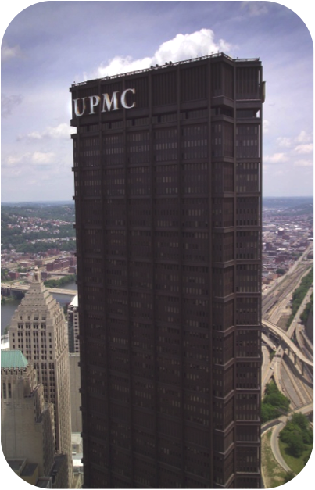
UPMC Background
$9 billion in revenue
20 hospitals operating over 4,200 beds; 187,000 admissions per year
4.5 million outpatient admissions; 750,000 emergency visits per year
1.5 million UPMC Health Plan members
More than 400 outpatient locations
54,000 employees; 2,700 employed physicians
$1.3 billion invested in IT over past 5 years
Notes:
Who we are

Slide 3
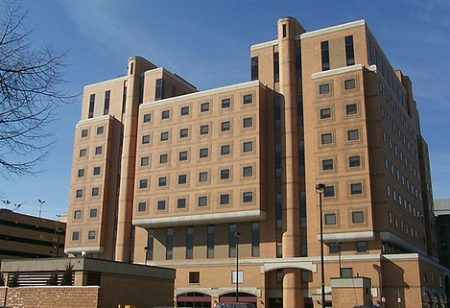
Nature of Work
Summer Associate at the UPMC Forbes Tower Data Center
Leadership development
Networking & Executive Spotlights
RFPs & Integrating consumer technology into the data center
40 hours per week, 12 weeks
Notes:
Who we are

Slide 4

How does it fit with CS?
Working in a tier 2 data center
Analysis work at a very large level
Scripting and device integration
Extreme virtualization
Working with consumer tools in enterprise environment
Notes:
Who we are

Slide 5
How did it turn out?
Microsoft Surface project
  Finished for me
Checklists
  Google vs Sharepoint
RFP
  Cancelled due to lack of funding
Begging superiors for more work
  Unsuccessful
Notes:
Who we are

Slide 6
Did I accomplish my goals?
No.
But I did learn a lot.
Notes:
Who we are

